Slide 1
New cloud features in Configuration Manager Technical Preview
Niall Brady
Enterprise Mobility MVP
twitter.com/ncbrady
windows-noob.com
niallbrady.com
facebook.com/groups/windowsnoob

Slide 2
Agenda
Understanding Tenant Attach
Operational value of Tenant Attach
Enabling Tenant Attach
Install applications from the admin center
Device Timeline
CMPivot
Running scripts
Enabling the VPN boundary type
Task Sequence Media support for cloud-based content

Slide 3
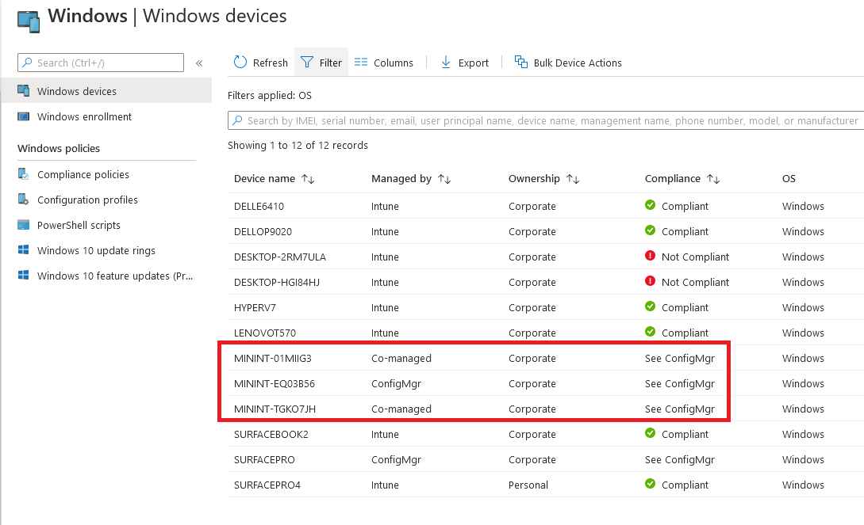
Understanding Tenant Attach
Tenant attach is not the same as co-management. Co-management is where devices are managed by Intune and ConfigMgr at the same time, with some (or all) workloads running in Intune or vice versa.
With tenant attach the device does not need to be enrolled into Intune and it can be managed by ConfigMgr or Intune and in addition it can also be co-managed.

Slide 4
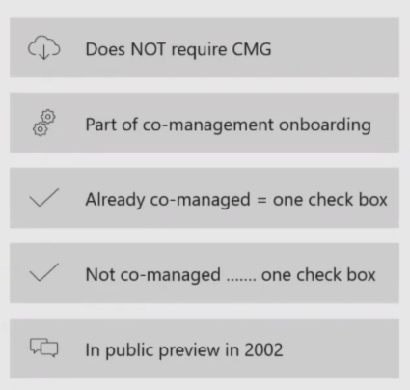
Understanding Tenant Attach
Tenant attach is where you literally attach your ConfigMgr site to the cloud
What’s available today is just the tip of the iceberg

Slide 5
Operational value of Tenant Attach
Surfaces some ConfigMgr management tasks and workflows to the MEM console
Visibility of all ConfigMgr managed systems in MEM console including servers
In TP2005 you can view device times from Endpoint Analytics
Ability to trigger client notification actions including Sync Machine Policy, Sync User Policy, App Evaluation in CM2002 and in TP2005 you additionally can trigger application installs, run scripts and perform CMPivot

Slide 6
Enabling Tenant Attach
An account that is a Global Admin for signing in when applying this change. Onboarding creates a third-party app and a first party service principal in your Azure AD tenant.
An Azure public cloud environment.
The user account triggering device actions has the following prerequisites:
Has been discovered with Azure Active Directory user discovery
Has been discovered with Active Directory user discovery
The Notify Resource permission under Collections object class in Configuration Manager.
Enable this pre-release feature from Administration > Overview > Updates and Servicing > Features.
Notes:
https://docs.microsoft.com/en-us/mem/configmgr/core/get-started/2020/technical-preview-2002-2

Slide 7
Enabling Tenant Attach
Turn on this feature
Read more @ https://www.niallbrady.com/2020/03/05/enabling-the-new-tenant-attach-feature-in-configuration-manager/

Slide 8
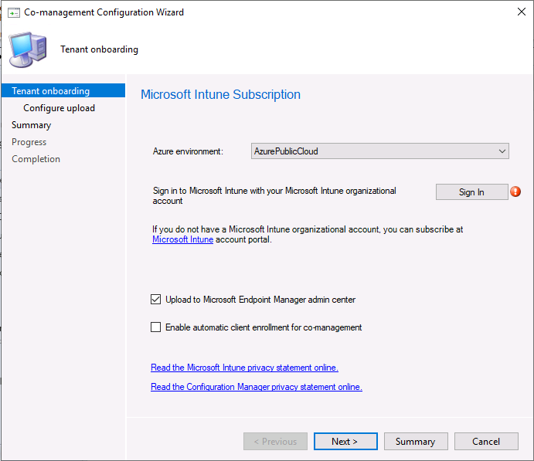
Enabling Tenant Attach
Fulfill the requirements
Start the Co-Management configuration wizard
Enable the checkbox to Upload to Microsoft Endpoint Manager admin center
Blogged here @ https://www.niallbrady.com/2020/03/05/enabling-the-new-tenant-attach-feature-in-configuration-manager/

Slide 9
Brief look at MEM console with Tenant Attach actions
https://aka.ms/memac
DEMO

Slide 10
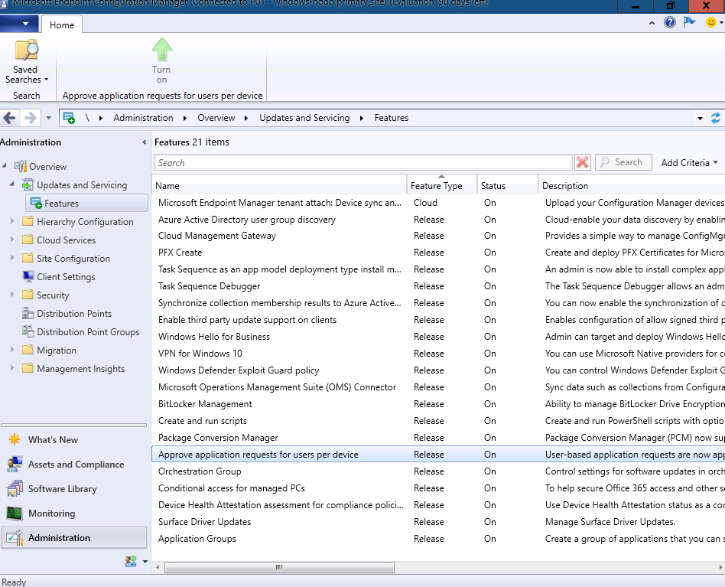
Installing applications
Enable the optional feature Approve application requests for users per device. For more information, see Enable optional features from updates.

Slide 11
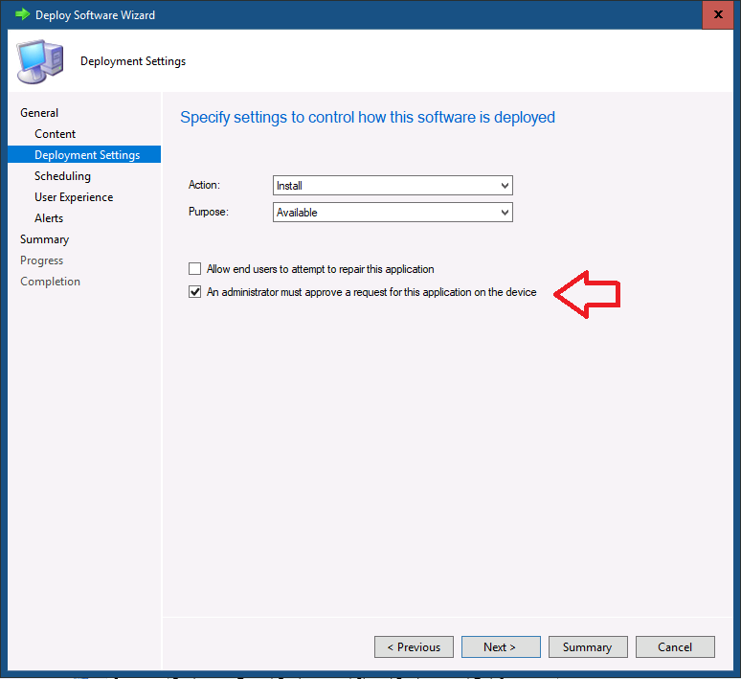
Installing applications
At least one application deployed to a device collection with the An administrator must approve a request for this application on the device option set on the deployment. For more information, see Approve applications.
User targeted applications or applications without the approval option set don’t appear in the application list.

Slide 12
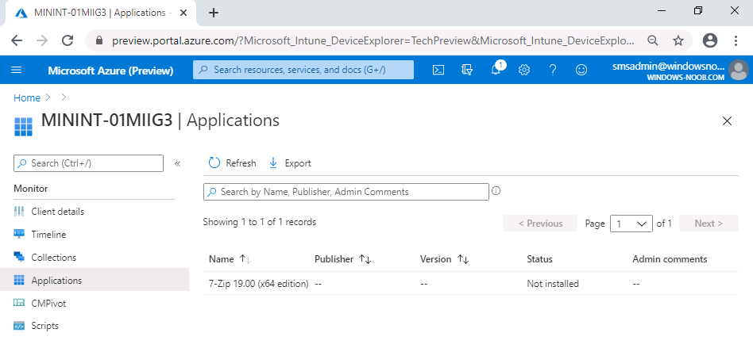
Installing applications
In the Admin center, locate your device and click on Applications. If your application matches the pre-reqs above then it should be listed.

Slide 13
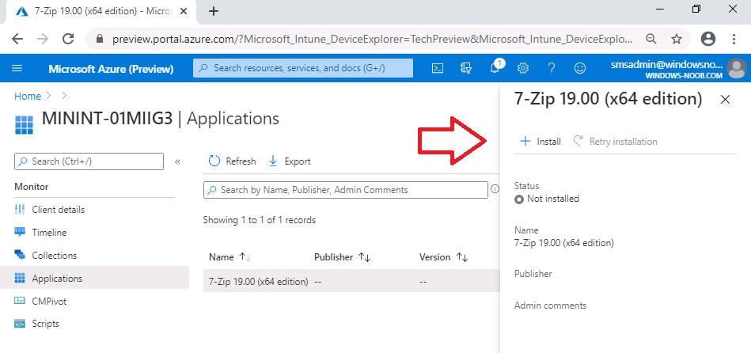
Installing applications
Clicking the app will bring up options to Install or Retry installation. In addition, it will list the status of whether it’s installed or not.

Slide 14
Installing applications
DEMO

Slide 15
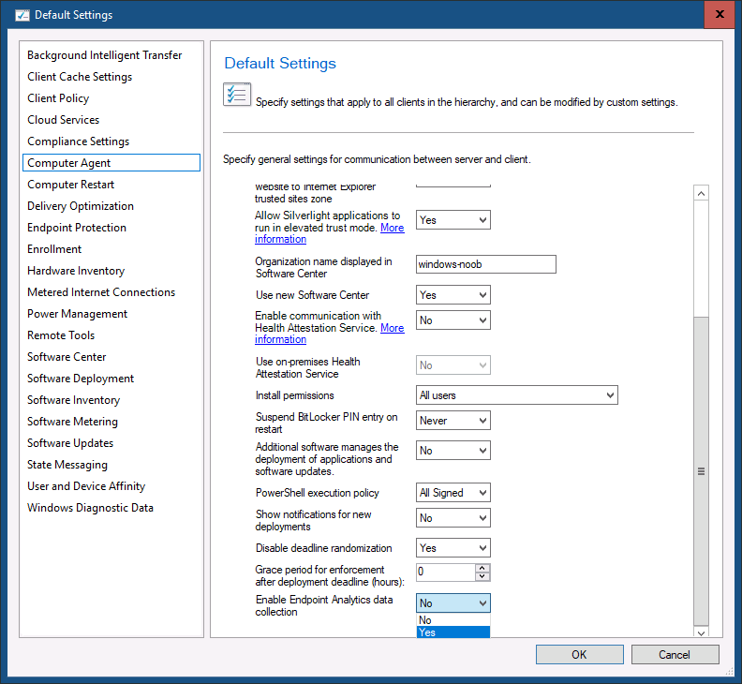
Device timeline
You’ll need to meet all of the prerequisites for Tenant attach: ConfigMgr client details:
An environment that’s tenant attached with uploaded devices.
One of the following browsers:
Microsoft Edge, version 77 and later
Google Chrome
The user account has been discovered with both Azure Active Directory (Azure AD) user discovery and Active Directory user discovery.
Meaning the user account needs to be a synced user object in Azure.
Enable Endpoint analytics data collection in Configuration Manager:
In the Configuration Manager console, go to Administration > Client Settings > Default Client Settings.
Right-click and select Properties then select the Computer Agent settings.
Set Enable Endpoint analytics data collection to Yes.
Only events collected after the client receives this policy will be visible in the admin center preview. Events prior to receiving the policy won’t be accessible.

Slide 16
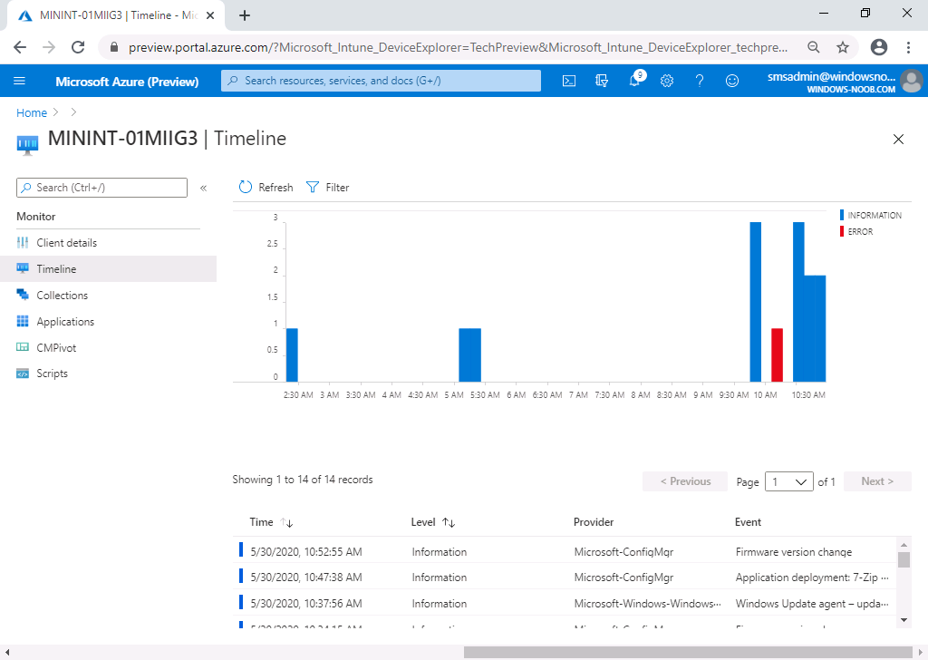
Device timeline
As data comes in, it will auto populate into the timeline
Use the Filter option to fine tune what you are seeing

Slide 17
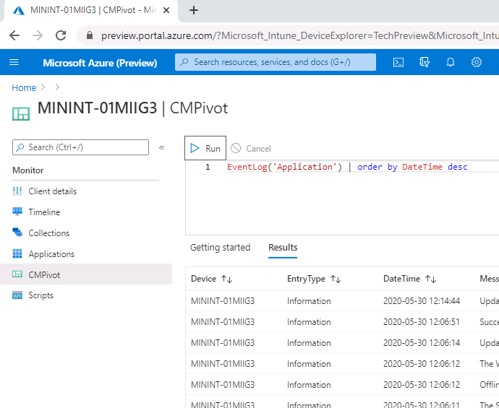
CMPivot
Bring the power of CMPivot to the Microsoft Endpoint Manager admin center. Allow additional personas, like Helpdesk, to be able to initiate real-time queries from the cloud against an individual ConfigMgr managed device and return the results back to the admin center. This gives all the traditional benefits of CMPivot, which allows IT Admins and other designated personas the ability to quickly assess the state of devices in their environment and take action.
For more information about CMPivot, see:
CMPivot sample scripts
CMPivot overview.

Slide 18
CMPivot
One of the following browsers:
Microsoft Edge, version 77 and later
Google Chrome
The user account has been discovered with both Azure Active Directory (Azure AD) user discovery and Active Directory user discovery. Meaning the user account needs to be a synced user object in Azure.
Additionally, the following items are required to use CMPivot:
Upgrade the target devices to the latest version of the Configuration Manager client.
Target clients require a minimum of PowerShell version 4.
To gather data for the following entities, target clients require PowerShell version 5.0:
Administrators
Connection
IPConfig
SMBConfig
Notes:
There are also permissions required Permissions
The user account needs the following permissions:
The Read permission for the device's Collection in Configuration Manager.
The Admin User role for the Configuration Manager Microservice application in Azure AD.
Add the role in Azure AD from Enterprise applications > Configuration Manager Microservice > Users and groups > Add user. Groups are supported if you have Azure AD premium.
Configuration Manager permissions for CMPivot:
Read permission on the SMS Scripts object
Run Scripts permission on the Collection.
Alternatively, you can use Run CMPivot on Collection.
Run Scripts is a super set of the Run CMPivot permission.
Read permission on Inventory Reports
The default scope.
https://docs.microsoft.com/en-us/mem/configmgr/core/get-started/2020/technical-preview-2005

Slide 19
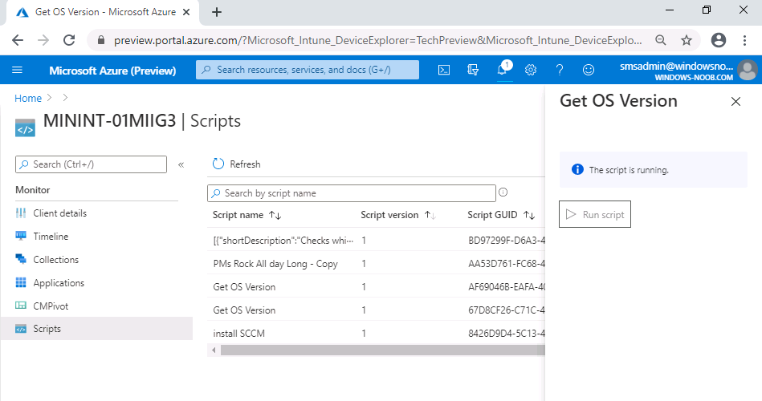
Run Scripts
Bring the power of the Configuration Manager on-premises Run Scripts feature to the Microsoft Endpoint Manager admin center. Allow additional personas, like Helpdesk, to run PowerShell scripts from the cloud against an individual Configuration Manager managed device. This gives all the traditional benefits of PowerShell scripts that have already been defined and approved by the Configuration Manager admin to this new environment.

Slide 20
Device Timeline
CMPivot
Run Scripts
DEMO

Slide 21
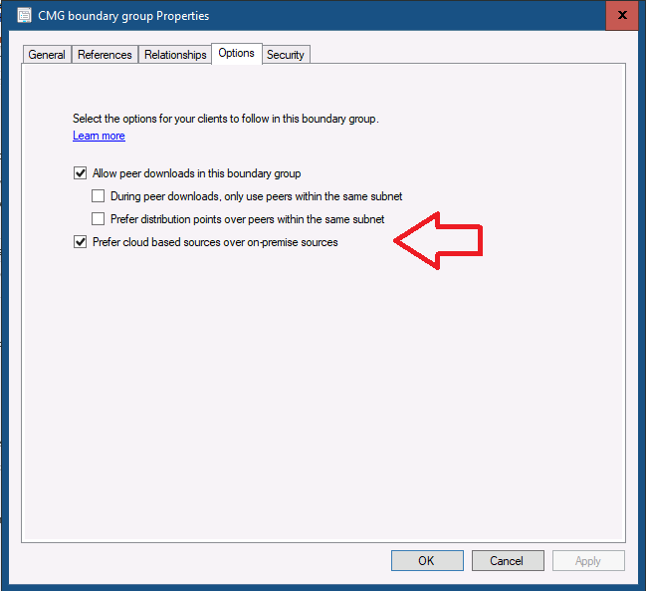
VPN boundary type
To use this VPN boundary during an OS deployment, make sure to also update the boot image to include the latest client binaries.
In the Configuration Manager console, go to the Administration workspace. Expand Hierarchy Configuration, and then select the Boundaries node.
In the ribbon, select Create Boundary.
Specify a Description, for example VPN boundary.
For the Type, select VPN. There are currently no additional configurations for this boundary type. Select OK to save and close.
Create a boundary group that includes this new VPN boundary. For more information, see Create a boundary group.

Slide 22
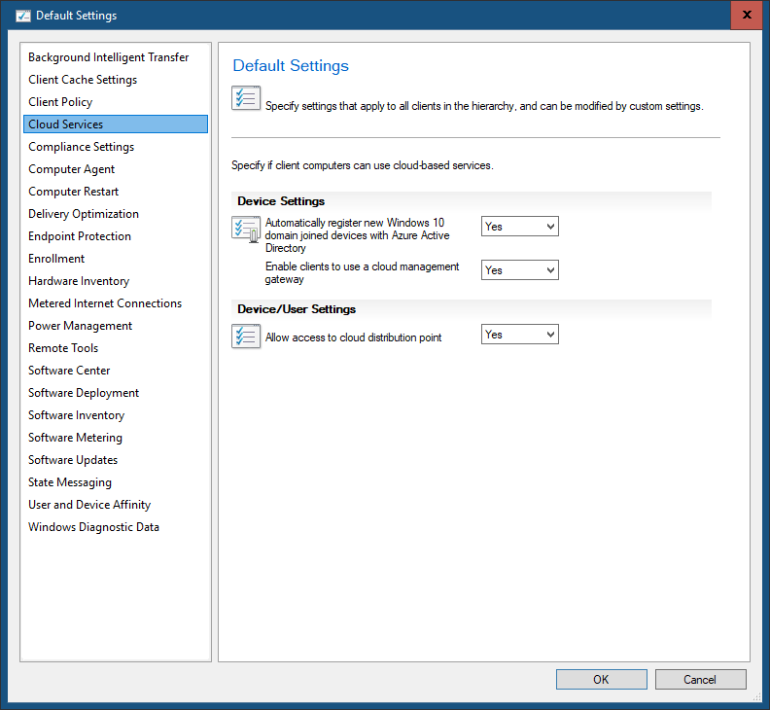
Task sequence media for cloud-based content
Enable the following client setting in the Cloud Services group: Allow access to cloud distribution point. Make sure the client setting is deployed to the target clients.

Slide 23
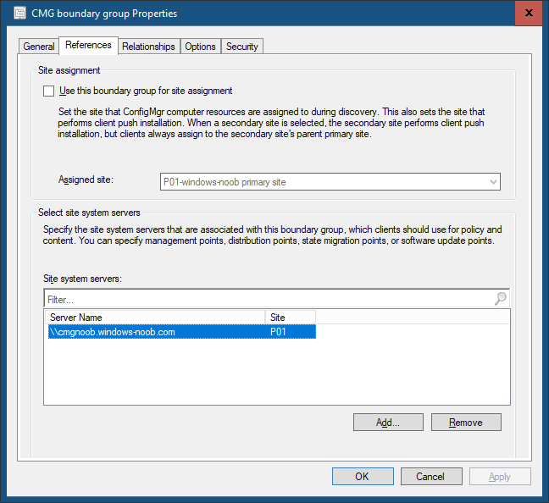
Task sequence media for cloud-based content
For the boundary group that the client is in, associate the content-enabled CMG or cloud distribution point site systems. For more information, see Configure a boundary group.

Slide 24
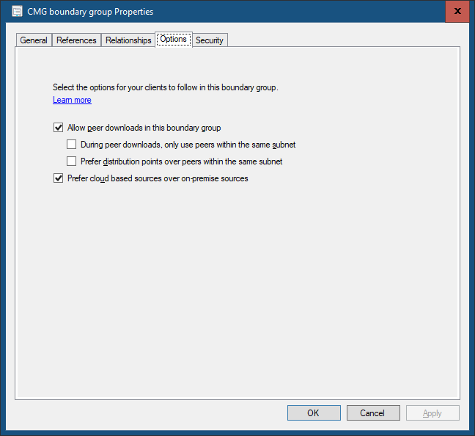
Task sequence media for cloud-based content
On the same boundary group, enable the following option: Prefer cloud based sources over on-premise sources. For more information, see Boundary group options for peer downloads.

Slide 25
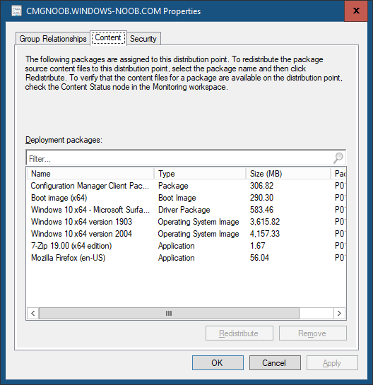
Task sequence media for cloud-based content
Distribute the content referenced by the task sequence to the content-enabled CMG or cloud distribution point.

Slide 26
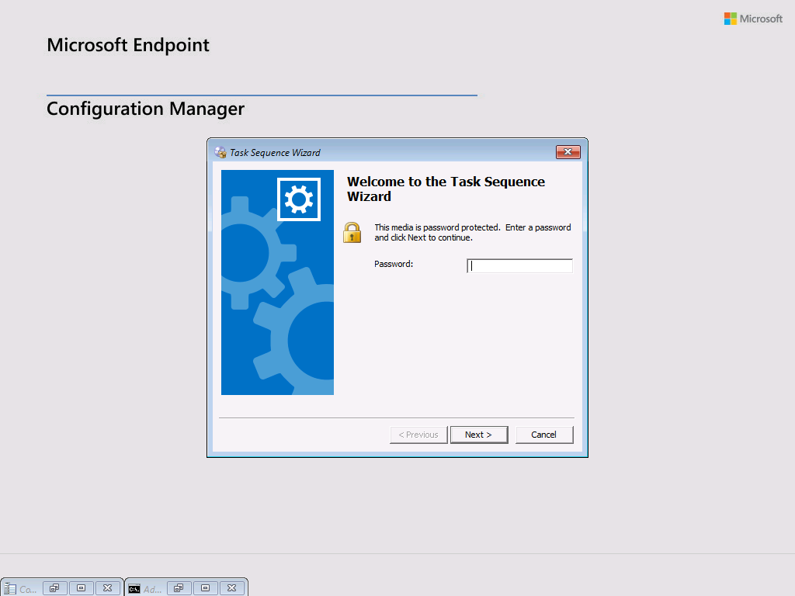
Task sequence media for cloud-based content
Start the task sequence from boot media or PXE on the client.

Slide 27
Task sequence media support from cloud sources
DEMO

